Slide 1
Strength in Singing
How our muscles work to make singing possible and powerful

Slide 2
For you created my inmost being; you knit me together in my mother’s womb.
I praise you because I am fearfully and wonderfully made; your works are wonderful,
I know that full well.
Psalm 139:13-14

Slide 3
Do you not know that your bodies are temples of the Holy Spirit, who is in you, whom you have received from God? You are not your own; you were bought at a price. Therefore honor God with your bodies.
1 Corinthians 6:19-20

Slide 4
I cried out to him with my mouth; his praise was on my tongue.
Psalm 66:17

Slide 5
Our bodies are made of many parts, and so are our voices.
Muscles
Cartilages
Various kinds of tissue
Blood vessels and arteries
Gooey stuff, for lack of a better word
Bones
Nerves
Tendons
And more!

Slide 6
The complexity of the body is reflected beautifully in the voice.
The primary function of the larynx is to protect the airway.
But we can also make a variety of sounds
The actual creation of the sound is pretty darn complex, and we don’t even fully understand how some of it works yet.
Parts of it are so small and move so quickly, we haven’t yet invented instrumentation that can give us a complete visual picture.
We’re still guessing a lot!
Leave it to God to make something so complex that we take for granted most of the time.

Slide 7
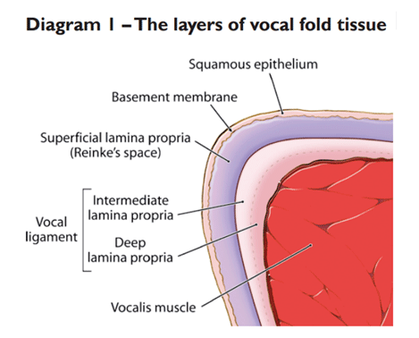
Let me tell you why I think God is brilliant.
Our vocal folds are designed for incredible action that almost no other structure in our bodies could handle.

Slide 8
Muscles need to be worked to stay strong.
We have “gear shift” areas in the voice that can be tricky to navigate.
Age-related changes make our muscles atrophy, and that can lead to instability in the voice and a whole host of other things.
  This includes our breathing muscles, too!

Slide 9
Here are some things to try:
Vocal slides
Singing in a “high” character voice
“Arioso”
Lip trills/buzzes

